Slide 1
Towards Universal Cross-Domain Recommendation
Jiangxia, Shaoshuai Li, Tingwen Liu*, et al. (2023WSDM)
Institute of Information Engineering
汇报人：阮滨
2023/5/18

Slide 2
背景
现有的跨域推荐方法要么旨在解决数据稀疏性问题，要么解决冷启动问题，缺少同时解决两个方向的算法模型

Slide 3
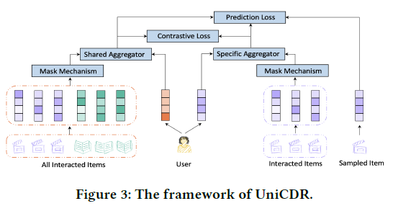
Overview

Slide 4





Aggregator
Mean-pooling aggregator
Domain-specific & domain-shared representations
User-attention-pooling aggregator
Item-similarity-pooling aggregator

Slide 5




Mask & CL
Masking mechanism
Contrastive loss calculating process
Interaction masking
Domain masking

Slide 6
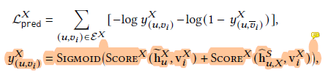

Train Process

Slide 7
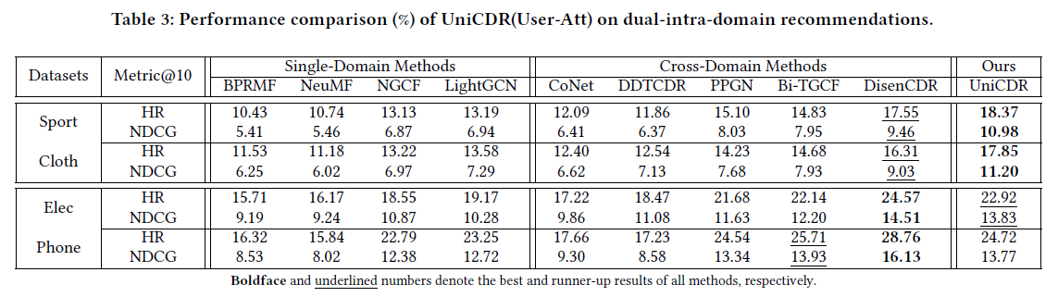
Performance

Slide 8
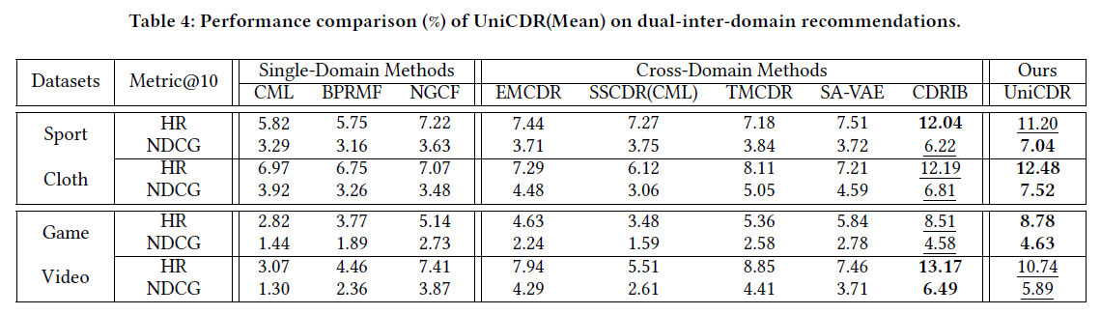

Slide 9
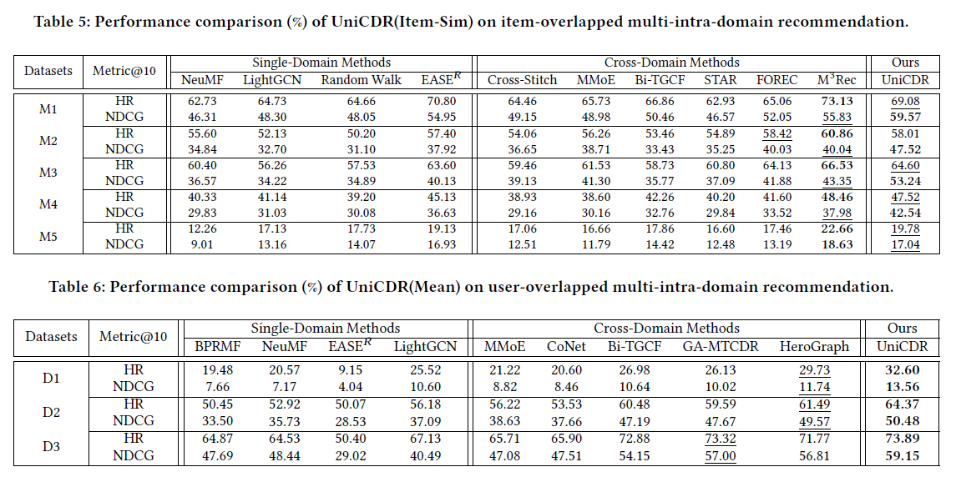

Slide 10
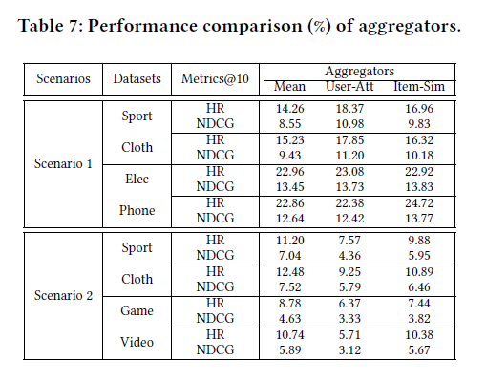
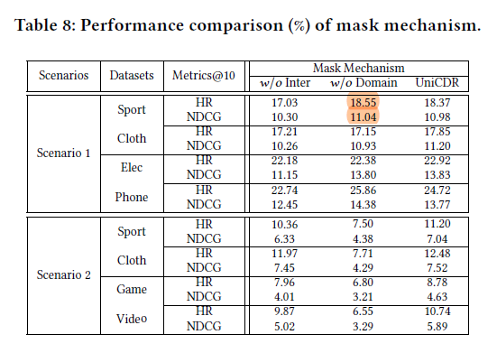

Slide 11
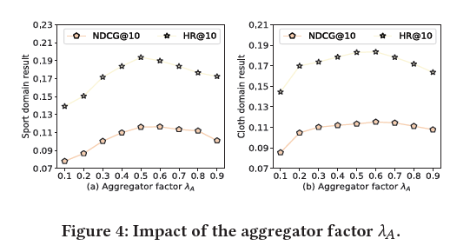
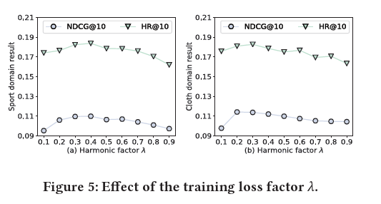

Slide 12
THANKS

